Slide 1
Unraveling the term “Validation”
Community Meeting
12:00 EST
20th Feb, 2024

Slide 2

There are multiple ways to approach validation, with no right or wrong answers:
It depends on:
Perspective: user, admin, package developer, regulatory agency…
Type of work/needs: exploratory, submission related, etc
Company culture
Many other things

Slide 3

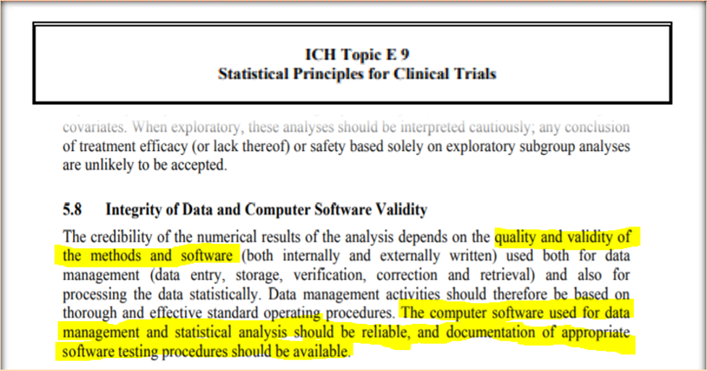
How do I validate R?

Slide 4
Is my software reliable?

Slide 5

How to Identify Reliable Software?
“I know the actual answer”
“It’s in the ballpark of what I might expect to see”
“I’ve used the software before and it did what I expected”
“Many others use the software and it does what they expect”
“When I learnt statistics, I was taught using the software”
“The software is used/cited in statistical literature”
“I trust that the software owner develops it using best practice”
“The software owner provides tests that I can use to verify that it is working”
Intuition
Community Exposure
Developer SDLC

Slide 6

Let’s discuss! When is an R package “validated”?
If many others use it regularly?
Bugs tracked?
Consistent behavior across version updates?
Active community?
Reproducibility of results using different systems?

Slide 7

Planned structure of today’s meeting
Chats in breakout rooms with 6-8 people (depending the number of participants today)
Someone from R validation hub in each room to help out
Approx. 10 minutes
We discuss together at the end

Slide 8
Thank you for joining!

